Slide 1
UMAP
Higher Understanding with Lower Dimensions
Henry Ward - GLBIO (5/20/2019)

Slide 2
UMAP algorithm overview
Construct weighted k-nearest neighbour graph
Define weights between neighbouring points by a function applied to a similarity metric
Measure cross-entropy between embedded weights and weights of real data
Apply gradient descent to optimize weights

Slide 3
Algorithm details
McInnes, L., Healy, J. & Melville, J. (2018). UMAP: Uniform manifold approximation and projection for dimension reduction. https://arxiv.org/pdf/1802.03426.pdf
Brief explanation of UMAP. https://www.math.upenn.edu/~jhansen/2018/05/04/UMAP/
Becht, E. et al. (2019). Dimensionality reduction for visualizing single-cell data using UMAP. Nat. Biotech. https://www.nature.com/articles/nbt.4314

Slide 4
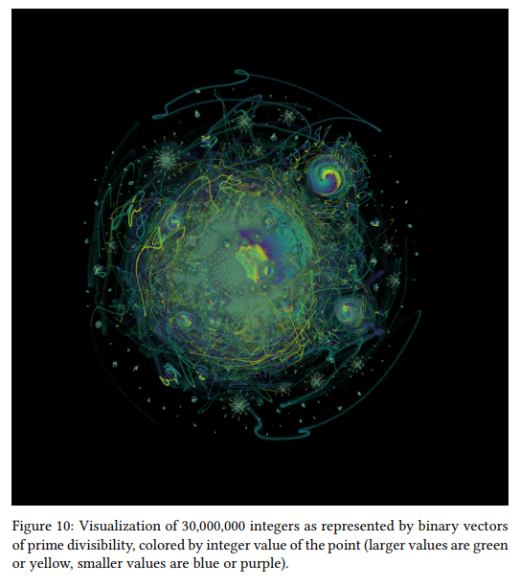
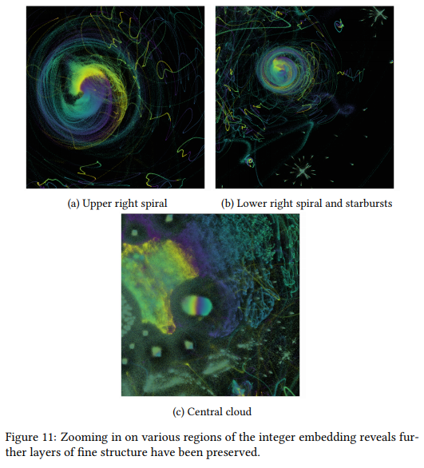
McInnes, L., Healy, J. & Melville, J. (2018).

Slide 5
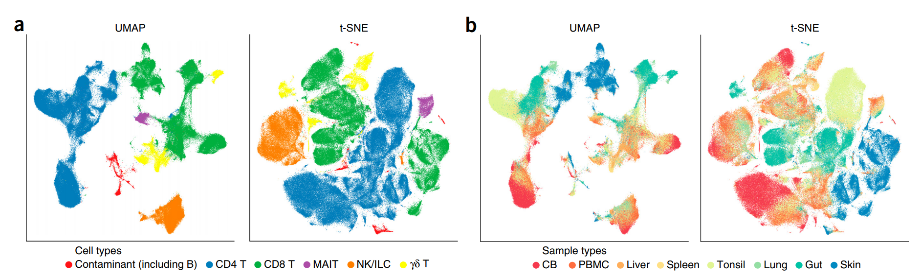
UMAP for single-cell analysis
Becht, E. et al. (2019).

Slide 6
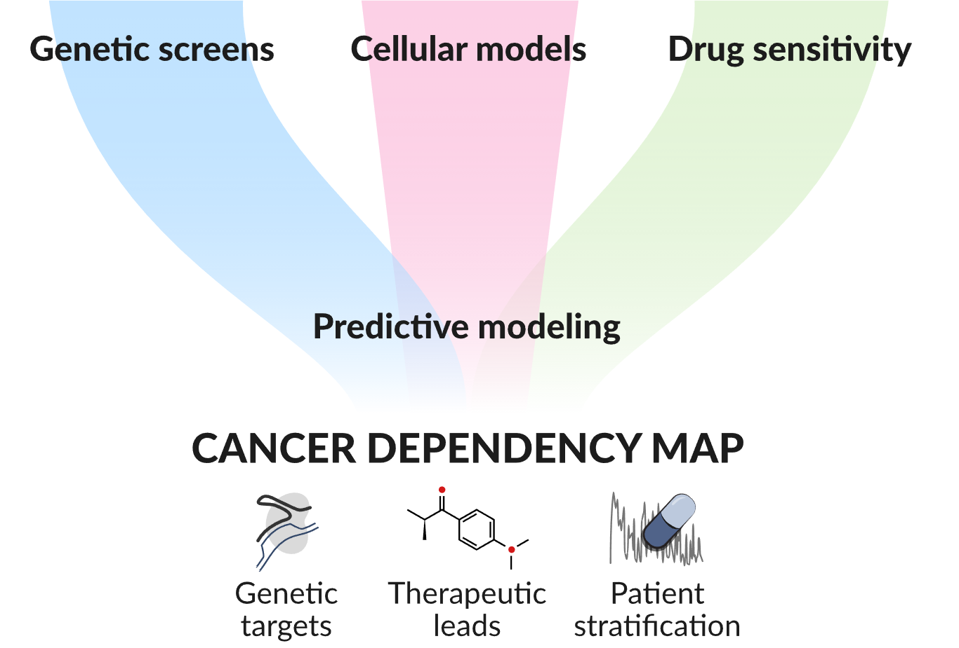
Cancer dependency map reveals essential genes
Source: Tsherniak et al. (2017). Defining a cancer dependency map. Cell.
Notes:
Genetic dependencies in cancer cell lines can give drug targets. More broadly, genetic dependency profiles give us genome-wide signatures that we and others have shown are highly informative of gene function. In practice, this typically involves taking the Pearson correlation between pairs of genetic dependency profiles.

Slide 7
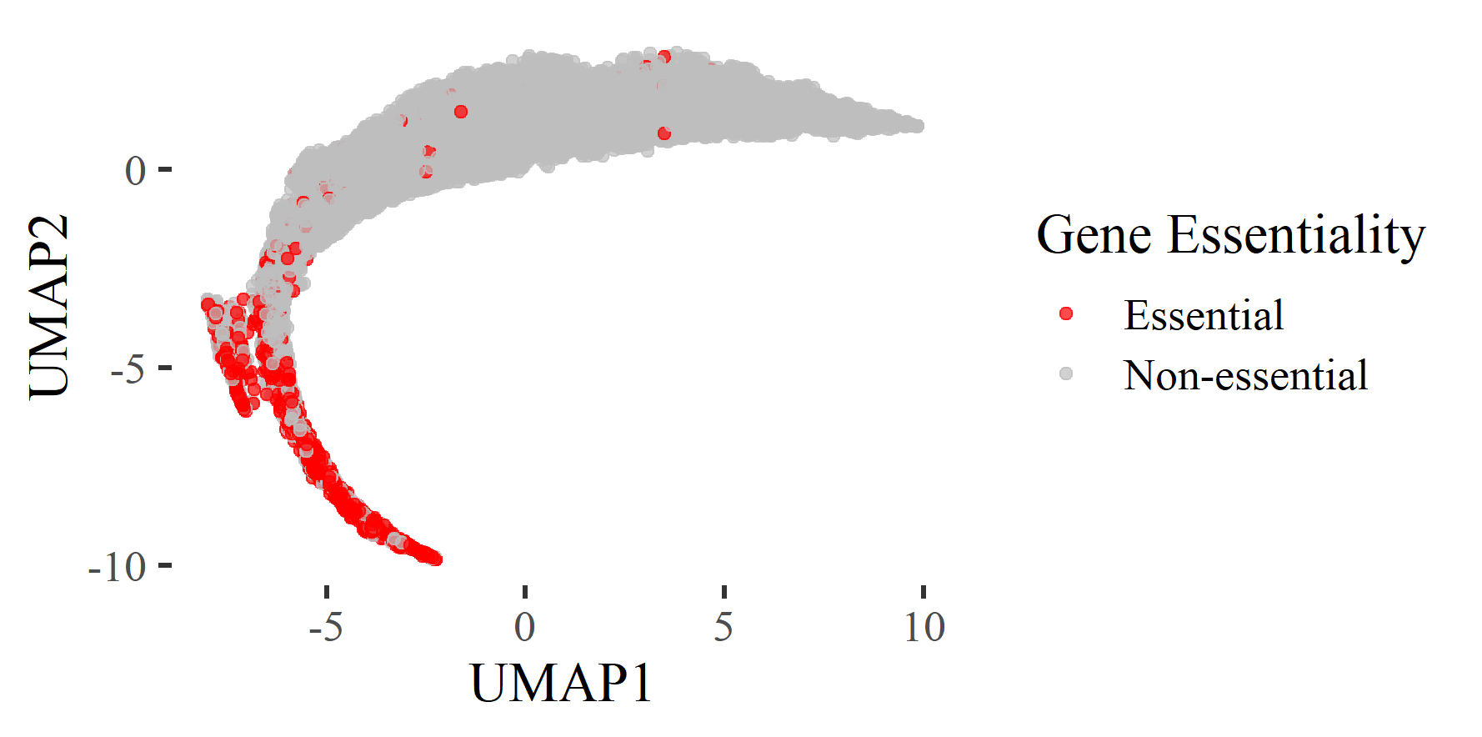
Cancer dependency map reveals essential genes
Notes:
Genetic dependencies in cancer cell lines can give drug targets. More broadly, genetic dependency profiles give us genome-wide signatures that we and others have shown are highly informative of gene function. In practice, this typically involves taking the Pearson correlation between pairs of genetic dependency profiles.

Slide 8
Weakness of UMAP
UMAP embeddings are not interpretable
Difficult to detect spurious embeddings due to small sample sizes or noise
Prioritizes local structure over global structure

